Slide 1
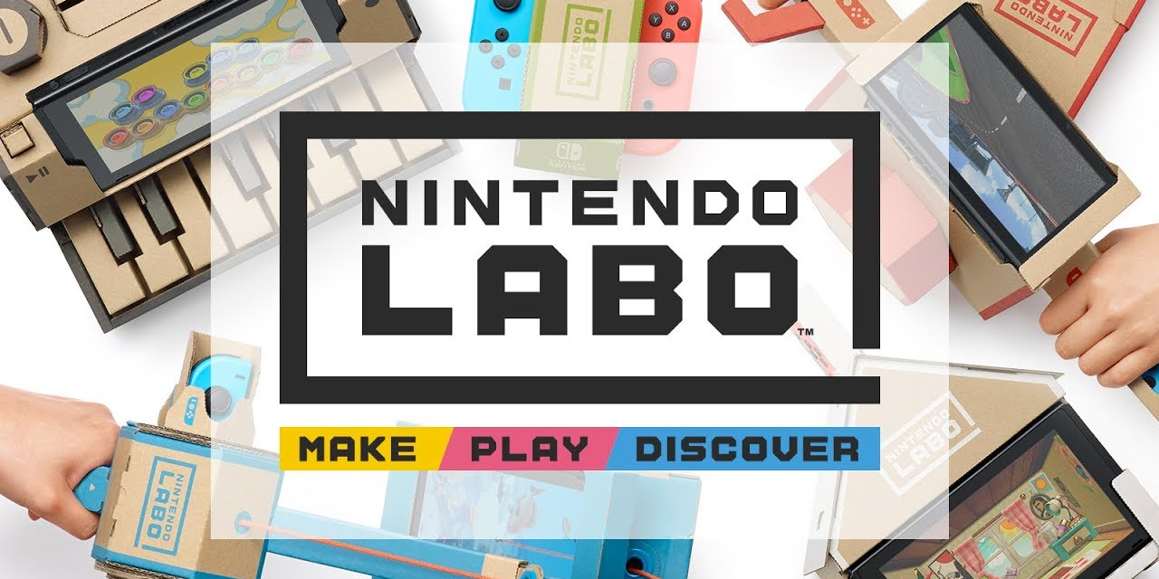

Slide 2
0. Index
Introduction.
Announcement Agency
4Ps: Price, Product, Place and Promotion.
Competition.
Life Cycle.
On the Market Study.
Promotion.
Distribution Channel.
Final Thoughts

Slide 3
1. Introduction.
First of all...
What is Labo?

Slide 4
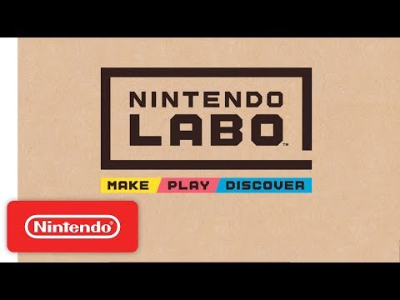
1. Introduction.
.

Slide 5
Labo is a toy.
And a complement to a gaming console.

Slide 6
Introduction.
1. Introduction.
Labo has not been released yet, and is scheduled for April 2018
Labo uses kits that include cardboard cutouts and other materials that are made to be assembled in combination with the Nintendo Switch console
The goal of Labo is to create toys that can interact with game software

Slide 7
58,7%
Nintendo’s domination of the handheld console market
Source: Statista.com

Slide 8
It is safe for Nintendo to launch a new, bold product like this because
they have a monopoly

Slide 9
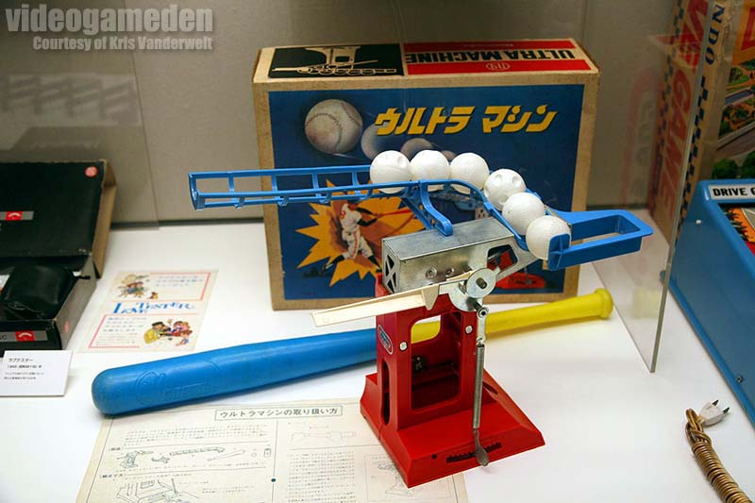
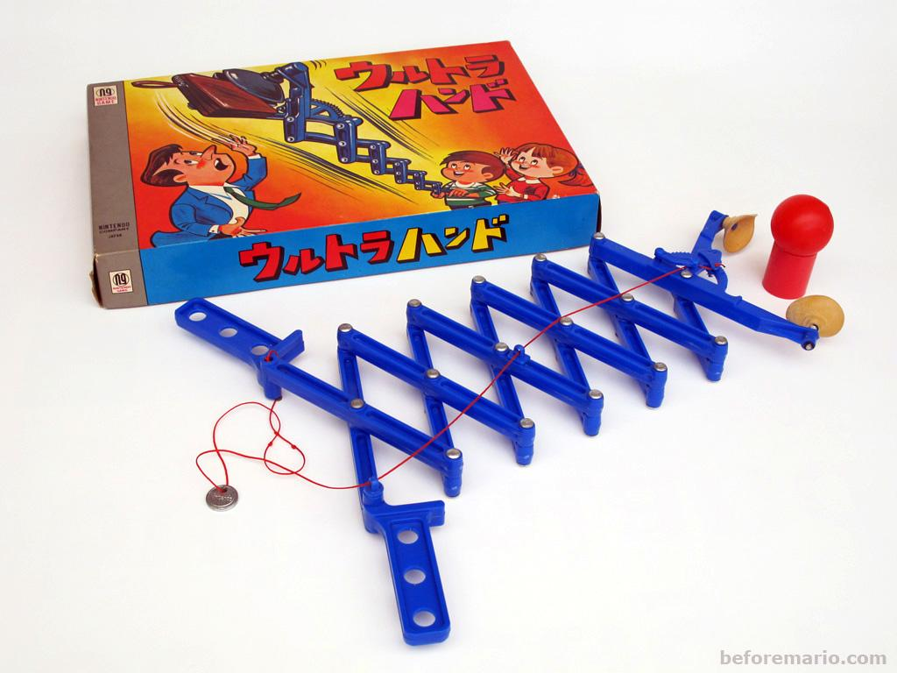
2. Announcement distribution.
Nintendo is a company that has been in the video game market since 1989 and that it started as a toy company.
Thus, they have a lot of data on what their customers like, so they decided to use their own marketing department to promote the Labo instead of relying in an external advertising agency.

Slide 10

3. Price, Product, Place and Promotion.
Nintendo has a very loyal user base. Most people that grew up playing Nintendo games still buy them.

Slide 11
3. Price, Product, Place and Promotion.
The principle elements of the marketing strategy used by Nintendo to promote the Nintendo Labo can be sum up in the following points:
Price: 70€ (basic kit) and 80€ (premium kit)
Product: cardboard complements for the Nintendo Switch console.
Place: specialized stores of technology, video games and toys.
Promotion: since Nintendo knows their customers are Internet media consumers, it has mainly used the Internet for promotion, where it has a large follower base (Twitch, Youtube)
In this kind of products, that are not of prime need, the demand is elastic, because according to the price, it will have more or less demand. No one will pay 200€ for

Slide 12
As the product is not of prime need, the demand is elastic because there will be more/less demand according to the price.
No one will pay 200€ for a piece of cardboard.

Slide 13
4. Competition.
It looks like it has no competition....
But it does!

Slide 14
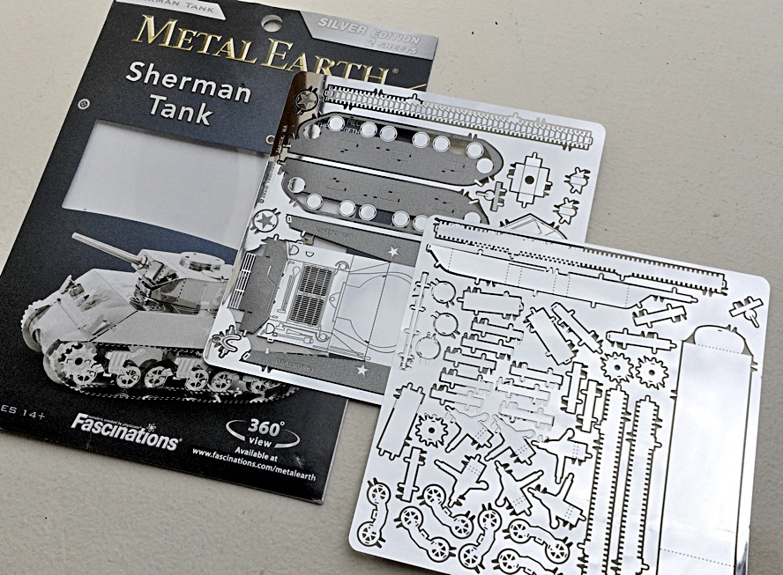
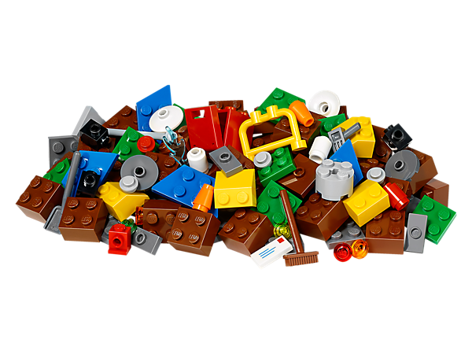
What are the substitutes of Labo?
So… what is Labo’s market differentiation?
Labo competes in a child-oriented market segmentation
People willing to buy Labo are already interested in similar toys

Slide 15
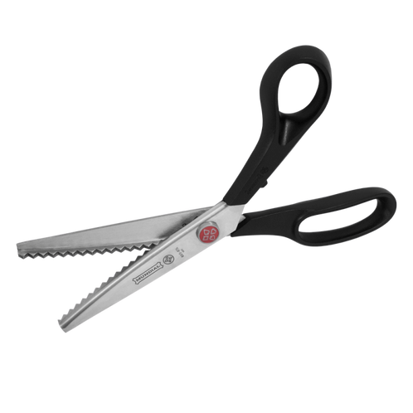
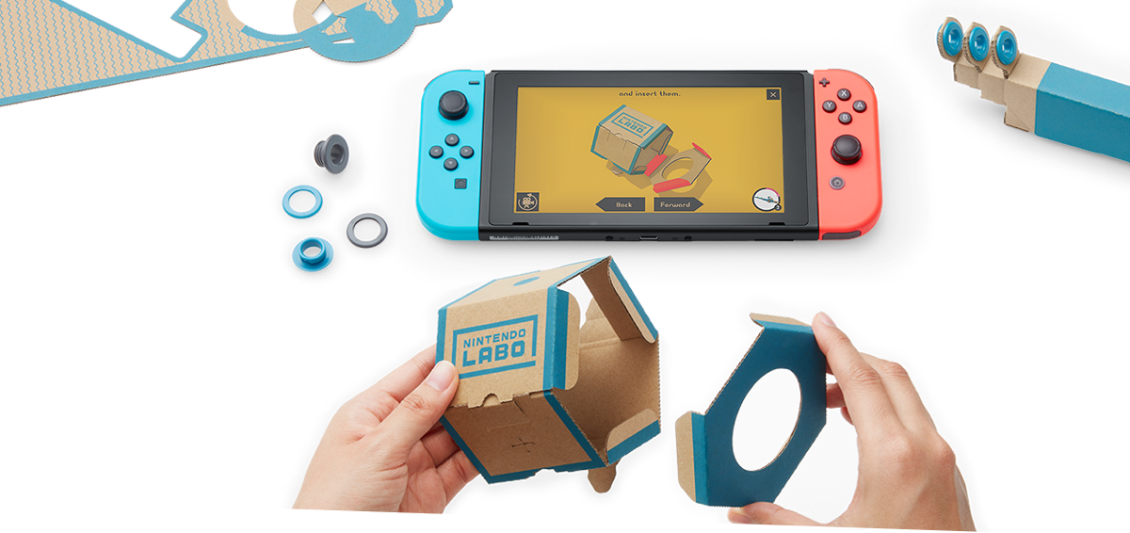
Nintendo Labo combines technology and
real life crafts. This way, the product has a double use for children.

Slide 16
5. Life Cycle.
As it is a product that has been announced, but it is not able to by it yet, we can say that this product is between the phase of introduction and the phase of growing, what is the moment were the number of sells grows quickly. So in conclusion, it is clear that the product is in the early stage of its life cycle.

Slide 17
6. On Marketing Study.
Nintendo has its own segment of loyal fans over which they know that they have a lot of influence. So it only needs to discover what other things can like to this people. So, basically, the target of this product are all the people that have a Nintendo Switch.
It also can have the intention of add another feature to the Switch to attract more consumers to buy the console, as Miyamoto said, one of the directives of nintendo, "our ultimate ambition is for a Nintendo Switch to be owned not just by every family, but by every single person".

Slide 18




7. Promotion.
The Internet is the main mean for its promotion. Social Networks such as YouTube, Twitch, Facebook and Twitter were used for announcing the arrival of Labo.
The use of these Social Networks was a great bet as they made fans hype about this product. Moreover, the video that is in the introduction went viral. This strategy was a great success as it made everyone who uses the Internet notice the arrival of Nintendo Labo.
As Nintendo knows very well the market, they have used all possible means to reach potential consumers: they have totally made viral this product, they let people try their products in events.
This strategy has been proved to be very effective as nowadays everyone who does not live under a rock knows about Nintendo Labo.

Slide 19



8. Distribution Channel.
The intermediaries that intervene in the distribution of Nintendo Labo are the different specialized stores in technology from the different countries. In Spain, the main stores that will sell this product are stores like MediaMarkt, GAME, Fnac, etc. However this stores do not buy directly Nintendo Labo from Nintendo, there are another element in the distribution channel, the distribuitor. The distributor that sells in wholesale to the intermediaries in Spain are companies like Enuc, Globomatik or Infortisa.

Slide 20
9. Final Thoughts
a sound approach to marketing
a solid user base (people who own a Switch console)
virtually no competition
a good distribution
Nintendo Labo has:
These factors make us think it can sell very well

Slide 21
Links
https://www.forbes.com/sites/mattperez/2018/02/02/after-hands-on-time-nintendo-labo-looks-like-a-sure-hit
https://www.nintendo.es/Nintendo-Labo/Nintendo-Labo-1328637.html

